Slide 1
UNDERSTANDING
RIGHTS REVERSION
WHEN, WHY & HOW TO REGAIN COPYRIGHT
TO MAKE YOUR BOOK MORE AVAILABLE

Slide 2
Hello!
Presenter Name
Title
Institution
Notes:
Introduce presenter(s).

Slide 3
Roadmap
Copyright & Publication Contracts
Why Revert Rights?
How to Revert Rights
Notes:
Here’s an overview of today’s presentation: First, to inform our conversation, I’ll provide a basic overview of copyright law and publishing agreements. Next, I’ll cover some background on why authors may want to revert rights and how reverting rights can be a helpful tool for increasing your book’s availability. Finally, I will turn to the nitty gritty of how to regain rights or otherwise secure permission from your publisher to make your book available in the ways you want.
Throughout, I will also share a few success stories from authors who were able to work with their publishers to achieve their goals using the strategies we cover today.

Slide 4
COPYRIGHT & PUBLICATION CONTRACTS
Notes:
Before we get to the concept of reverting rights, it’s useful to share a brief background on copyright law and publishing agreements.

Slide 5
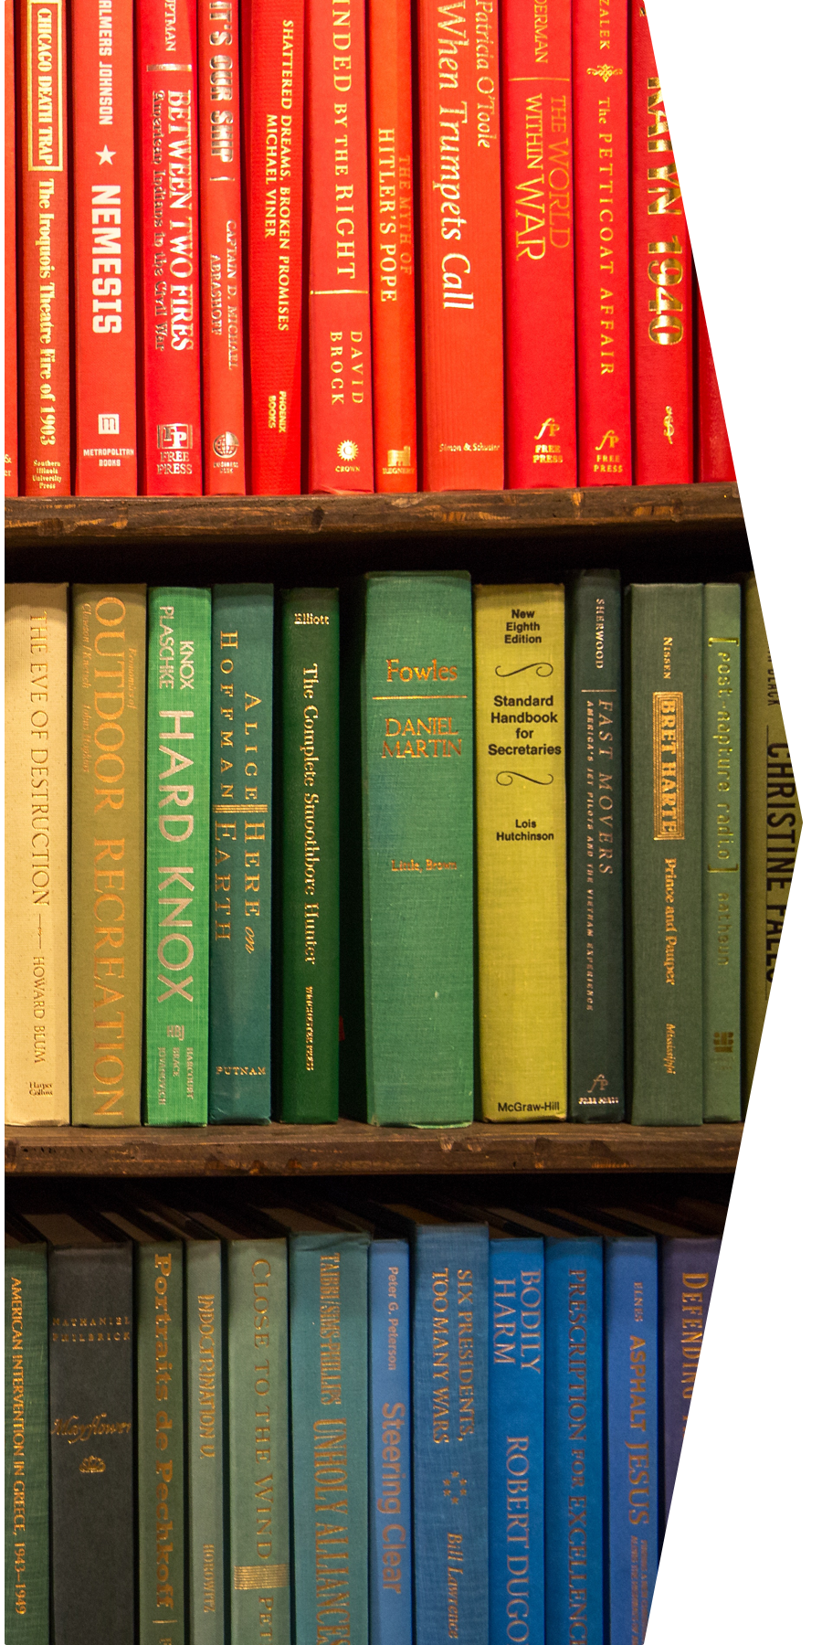
Copyright Basics
Copyright is a bundle of exclusive rights that (typically) vests with the author of the work.
Make Copies
Make Derivative Works
Distribute
Publicly Display
Publicly
Perform
Notes:
When you write a book, an article, or some other work of original expression, you generally will have a copyright in that work from the moment you commit that expression to paper (or save to your computer, as the case may be). These days, there is no need to register your work with the Copyright Office or place a copyright symbol on your work before it is eligible to receive copyright protection. With some exceptions (such as writing something at the behest of your employer), you will generally hold the copyright to that work simply by being the author of the work.
Copyright is a bundle of exclusive rights that only the copyright holder, or someone authorized by the copyright holder, can exercise—unless their use falls under an exception to copyright law (like fair use). These rights include the right to make copies of that work and the right to make other works derived from that work, such as translations, abridgements, or movie adaptations. These rights also include the rights to distribute, publicly display, and publicly perform the copyrighted work.
By holding the copyright in a work, an author can usually prevent all others from exercising these rights (barring an exception or limitation to copyright, like fair use). This means the copyright holder of a book can print and sell copies of the book, create new works that incorporate the original book’s content, read the book aloud to public audiences, or publicly display its text.

Slide 6
Publication Contracts
Many authors transfer some or all of these rights to their publishers.
When an author does this, she may no longer be able to exercise these rights without infringing her publisher’s rights in the work.
Notes:
However, the copyright owner can authorize others to do these things, or can even transfer ownership of the copyright to someone else. When an author signs a publishing agreement for her book, she frequently transfers some or all of these rights to her publisher. And authors are often asked to sign away these rights “for the life of copyright,” which today lasts for a very long time – 70 years after the death of the author. Once an author does this, she can no longer exercise those rights herself, as they may belong exclusively to her publisher.
This presents a problem for authors who, possibly like some of you, have signed away their rights but now want to do something with their books that their publishers aren’t doing.

Slide 7
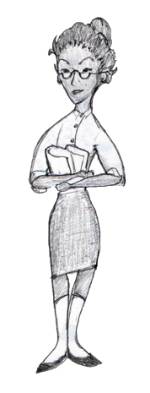
Rafaela Reversion
Rafaela transferred exclusive rights to publish all print, electronic, and digital editions of her book.
Her book is no longer available for purchase in print.
Can Rafaela create and sell her book as an e-book without infringing her publisher’s rights?
Notes:
Consider the case of Rafaela Reversion. When Rafaela signed her publishing agreement, she granted her publisher exclusive, worldwide rights to publish all print, electronic, and digital editions of her book. Rafaela’s tome has fallen out of print, but she would really like to see it brought back to life as an e-book.
Q: Can Rafaela create and sell her book as an e-book without infringing on her publisher’s rights?
A: Because Rafaela transferred electronic and digital rights to her publisher, she can’t independently create an electronic version of her book herself—only her publisher has the right to do so. Instead, Rafaela has three options: (i) Rafaela will need to revert rights from her publisher, (ii) get permission from her publisher to create the e-book herself, or (iii) convince her publisher to release an e-book version of her work.

Slide 8
Getting Rights Back
Exercising a clause in a publication contract (often called a “reversion clause”) that permits an author to regain some or all of her rights when a triggering condition is met.
Negotiating to regain rights in the absence of a reversion clause (or when the triggering conditions for the reversion clause are not met).
or
Reaching another kind of agreement or a compromise that realizes the author’s goals.
Notes:
Like Rafaela, many authors want to make their in-copyright books more accessible to their readers, but are unable to do so because they transferred the necessary rights to their publishers. We’ll cover a few different ways that, if you are in a position like this, you can get rights back to make your book available in the ways that you want.
First, you might be able to exercise a right of reversion, a contractual provision that permits an author to regain some or all of the rights in her book from her publisher when certain specified conditions, sometimes known as triggering conditions, are met.
Second, you might be able to regain rights to your book, or otherwise achieve your goals for your book, through negotiation techniques—even if you don’t have a contractual right of reversion or if you haven’t met the triggering conditions in your reversion clause.
Third, it can also be possible for you to achieve your goals for your book’s availability without reverting rights at all—sometimes, it makes more sense for an author to come to another kind of agreement or compromise with her publisher. For example, if your goal is to simply bring your out-of-print book back into print, you might be able to convince your publisher to bring it off its backlist and offer it for sale using print-on-demand services.

Slide 9
WHY REVERT RIGHTS
Notes:
This short section will cover some possible motivations authors might have to revert rights to their books. Before you revert rights, it is important that you identify your goals for your work and a plan for what you will do with your book with your rights back in hand.

Slide 10
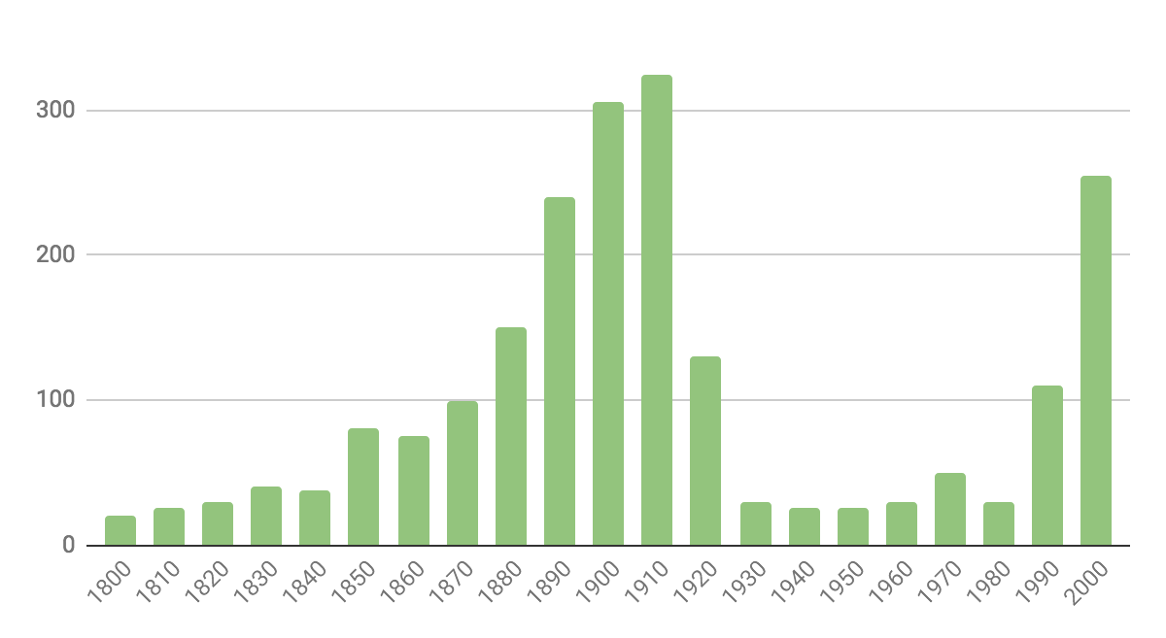
The Case of the Missing Books
New Editions of Books Available on Amazon
based on research by Prof. Paul Heald
Notes:
Some authors’ books may have fallen out of print entirely, making it difficult for would-be readers to discover them. This is a very common problem for books. Law professor Paul Heald demonstrated the reality of these “missing” books through his study tracking the numbers of new editions of books that are currently available for sale on Amazon.
A bit of background will be useful to understanding this chart. Works published after 1923 may still be in-copyright. Books first published in the U.S. in or before 1923 are part of the public domain—no one owns the copyright to them anymore, so anyone can use the material in them. As you can see, there are many more editions available for sale of these books than there are of more recent books.
Books published after 1923 may still be in copyright. It is much harder for a reader to find and cite to a new edition of these more recent books than of older books that are in the public domain. This creates the curious phenomenon of some newer books being harder to find than significantly older books (with the exception of books that have been very recently published). This is because most books have a very short commercial life, and publishers have little incentive to keep works in print once that commercial life is over.
Reverting rights will help readers find, read, and cite to in-copyright books that are currently “missing,” especially books published in the last century that have fallen out of print or otherwise become inaccessible to readers through traditional commercial outlets.

Slide 11
Motivations to Revert
James O’Donnell
Tracee Garner
David Ullman
Wanted out-of-print book to be available: made openly available online
Wanted to complete a trilogy: repackaged and released with a third book
Wanted to reduce costs for readers: self-published textbook at a lower price point
Notes:
There are many reasons that an author might be motivated to revert. Here are a few real-life examples:
James O’Donnell: When James O’Donnell’s book, Augustine: Confessions, went out of print, he reverted the rights and made the book openly available online. Almost ten years later, his former publisher approached him asking to issue a reprint of the book, to which James agreed. James connects the fact that his book was openly available online in the intervening years with the ongoing interest in his book… and the second book deal.
Tracee Garner: Tracee had written two novels in a planned trilogy, but never finished the series. After fans requested that she finish the series, Tracee reverted rights to the first two books so that she could edit and repackage them with a new book to complete and self-publish the trilogy.
David Ullman: David Ullman’s publisher steeply increased the price of his textbook over his protests. David felt that the price was killing sales of the book, so he requested a rights reversion. With his rights back in hand, David released a new edition of the book at a price he felt students and practitioners can afford. David notes that even though he drastically cut the list price, he still makes more per book than when the book was sold through his former publisher.

Slide 12
HOW TO REVERT RIGHTS
Notes:
With this background information under our belts, it’s now time to get into a bit of detail about how to revert rights.

Slide 13
Do you need to revert rights to do what you want?
NO
Proceeding without a right of reversion
NO
YES
NO
BE READ!
YES
YES
Does your contract include a reversion clause?
Are you eligible to exercise your reversion clause?
Notes:
This flowchart captures the process of reverting rights—or otherwise securing your publisher’s permission—to increase your book’s availability. This section of the presentation will take you through each step associated with this flowchart.
First up: you need to determine whether you actually need to revert rights, or otherwise get your publisher’s permission, to make your book available in the ways you want. It’s important to remember that not all authors will need to revert rights in order to achieve their goals for their books. Sometimes, an author already holds the rights she needs to make her book available in the ways she wants.

Slide 14
Do You Need to Revert?
Decide how you want to increase your book’s availability.
Find (and read!) your contract.
Determine what rights you granted to your publisher. Do you even need to revert rights in order to make your book available in the ways you want?
Notes:
Before trying to revert rights, you should think about your goals for your book: Do you want to make it available for free in an online open access repository or do you want to continue to offer it for sale? Do you want to publish an updated edition? Do you want to publish your book in a more affordable format? Once you get your rights back from your publisher, you will need to find a way to make your book discoverable and readable for your readers. This step is very important because if you revert rights without having a plan in place, you risk making your book even less available.
After you think about your plans, you should find and read your contract. If you don’t have a copy, you can request one from your publisher. If for some reason your publisher can’t locate your contract, don’t worry! You can still notify your publisher of your intent to revert rights, or otherwise make your book available in the ways you want, as we will discuss later.
From reading your contract, you may find that you already have the rights you need to do what you want with your book because you never granted them to your publisher in the first place.
For example, if you only granted your publisher exclusive North American rights to publish all print editions of your book, then you can publish a print edition in Germany without reverting any rights.
Likewise, if you only transferred to your publisher the right to publish English-language editions of your book, then you can publish a Spanish-language translation without reverting any rights.

Slide 15
Martin Maritime
Martin transferred exclusive rights to publish only print and electronic editions of his novel.
He is approached by a film student who wants to make a movie based on the book.
Can Martin license motion picture rights in his book without reverting rights from his publisher?
Notes:
Let’s try a hypothetical here. Martin Maritime wrote a novel about love on the high seas. In his contract, he granted his publisher exclusive, worldwide rights to publish all print and electronic editions of his novel. Recently, a film student approached Martin about making a movie based on his book. Martin loves this idea because he thinks a film would bring his story to a wider audience.
Q: Can Martin license motion picture rights to his book without reverting rights from his publisher?
A: Because Martin never granted his publisher (or anyone else) the right to make or license motion pictures based on the novel, he is able to grant the student’s request himself, without having to revert any rights from his publisher.

Slide 16
Do you need to revert rights to do what you want?
NO
Proceeding without a right of reversion
NO
YES
NO
BE READ!
YES
YES
Does your contract include a reversion clause?
Are you eligible to exercise your reversion clause?
Notes:
So, if you are like Martin Maritime and already have the rights you need to do what you want with your book because you never granted them to your publisher in the first place, you can proceed with your plans.

Slide 17
Do you need to revert rights to do what you want?
NO
Proceeding without a right of reversion
NO
YES
NO
BE READ!
YES
YES
Does your contract include a reversion clause?
Are you eligible to exercise your reversion clause?
Notes:
If, on the other hand, you find that you have handed over the rights you need, then you will need to find a way to get these rights back, or otherwise come to another kind of agreement with your publisher to realize your goals. The first step is to determine whether your contract includes a reversion clause.
Keep in mind that not all contracts include a reversion clause. If yours does not, you can still negotiate a reversion of rights or other compromise with your publisher, and I will address this scenario shortly. But now, let’s turn to a discussion on how to identify and interpret reversion clauses.

Slide 18
The Lowdown on Reversion Clauses
Might be called:
Might be Triggered by:
Out-of-print clause
Discontinuance clause
Reversion of Rights clause
Termination clause
and more...
Out-of-print status
Sales/revenue thresholds
Stock level threshold
Term-of-years expiration
and more...
Notes:
Many, but not all, contracts have some kind of reversion clause. Reversion clauses go by many names, including: Out-of-print Clause; Discontinuance Clause; Reversion of Rights Clause; Termination Clause; or something else entirely.
Regardless of its title, you will ultimately identify a reversion clause by the information it contains. Reversion clauses have different conditions that, when met, trigger an author’s eligibility to revert. The condition might be that the publisher’s stock must fall below a certain threshold, or that the publisher’s sales or revenue earned on the book must fall below a certain threshold. Alternatively, the condition might that the term of years of the grant has expired or that the book is no longer “in print.”
It’s worth noting that many publishers consider a book to be “in print” even if it is only available as an e-book. The mere fact that printed physical copies are no longer available does not necessarily mean that a publisher will consider a book to be “out of print” for purposes of reversion. Similarly, many publishers consider sales of e-books to count towards the sales threshold, even if no printed copies of the book are sold. Some contracts will spell these qualifications out, but others will not—especially older contracts. Keep this in mind as you evaluate your reversion clause.

Slide 19
Sample Reversion Clause #1
If the Work shall become out of stock and will not be reprinted and is unavailable for sale in any English language edition issued or licensed by the Publisher, then the Author may give notice in writing to the Publisher to reprint or reissue the Work. If no agreement is reached for the reprinting or reissuing of the Work within 3 months of the Author’s request, all the Publisher’s rights in the Work shall terminate. For the avoidance of doubt, a Work shall not be considered out of stock or unavailable if it is available in whole or in part by print on demand or online or in any other electronic format.
Notes:
Let’s take a look at a couple of reversion clauses that come directly from real contracts. At first glance, they can seem intimidating. But if you take it line by line, it begins to make sense. Let’s try it together.
This clause starts the triggering condition: “If the Work shall become out of stock and will not be reprinted and is unavailable for sale in any English language edition issued or licensed by the Publisher…”. This sentence explains that once the publisher is “out of stock” of the book, has no plans to reprint it, and no longer makes it available for sale in an English-language edition, it becomes eligible for reversion.
We have to look to the last sentence of the clause for more information on what “out of stock” and “unavailable” mean: “a Work shall not be considered out of stock or unavailable if it is available in whole or in part by print on demand or online or in any other electronic format.” In other words, a work is not eligible for reversion if it’s available for sale by the publisher in English in any of these formats.
The clause also has a written notice requirement: “then the Author may give notice in writing to the Publisher to reprint or reissue the Work.” This section of the clause outlines the author’s obligation to provide written notice to her publisher of her intent to revert. It is not uncommon for a reversion clause to give the publisher the option to reprint or reissue the work within a certain period of time (a grace period) rather than revert.
The clause also stipulates the timeframe for reversion: “If no agreement is reached for the reprinting or reissuing of the Work within 3 months of the Author’s request, all the Publisher’s rights in the work shall terminate.” This text defines the publisher’s timeline for reverting rights. As you can see, this clause includes a grace period. Once the author has met her triggering condition and provided written notice of her intent to revert, the publisher will then have 3 months to reprint or reissue the author’s work. If it does not reprint or reissue the author’s work during this period, the rights revert to the author.
So, to sum up this reversion clause: an author whose work has fallen out-of-stock as defined by the clause, must provide written notice to her publisher of her intent to revert. Her publisher then has 3 months to reprint or reissue her work. If her publisher does not, then rights revert to the author.

Slide 20
Sample Reversion Clause #2
Should the Publisher fail to keep the full-length work in print, and after written demand from the Author, decline or neglect to bring it back into print within six (6) months the Author may terminate this Agreement and all rights granted hereunder shall revert to the Author. The Work shall be deemed in print if available in any of Publisher’s full-length print editions available through normal U.S. trade channels. If the Work is only available as an Electronic Book or through a form of print on demand capability, the Work shall not be deemed in print unless such Electronic Book and/or print-on-demand capability shall generate combined sales of no less than 250 copies per year.
Notes:
This is another reversion clause pulled from a real publishing contract. This reversion clause has a more detailed definition of “in print.” The legal jargon appears dense, but if we tackle it line by line, the meaning is relatively straightforward.
The first part of this clause is the triggering condition: “Should the Publisher fail to keep the full-length work in print…”. This means that the work must fall out of print to be eligible for reversion.
We must look later in the clause for detail on the publisher’s definition of “in print.” “The Work shall be deemed in print if available in any of the Publisher’s full-length print editions available through normal US trade channels.” This is the first part of the definition of “in print.” It says that if the book is available in traditional print format (paperback, hardcover), then it will be considered in print and not eligible for reversion.
However, remember that I said this clause has a more complicated definition of “in print.” This is the second part of the definition: “If the Work is only available as an E-book or through Print on Demand, the Work shall not be deemed in print unless the E-book or Print on Demand formats generate combined sales of no less than 250 copies per year.” This means that if the book is only available as an e-book or through print-on-demand technology, then as long as it is selling 250 or more copies per year, the book will be considered in print. If, however, the book is only available in e-book and print-on-demand formats and is selling less than 250 copies per year, then the triggering condition for reversion has been met.
This clause also has a written notice requirement: “after written demand from the author”. This just means that, like the previous reversion clause we read together, the author must provide written notice of her intent to revert once her triggering condition has been met.
Finally, this clause also has a timeframe for reversion: “[if the publisher] . . . decline[s] or neglect[s] to bring it back into print within 6 months, the author may terminate this agreement and all rights granted hereunder shall revert to the author.” Like in the other clause, this publisher will then have a grace period in which to bring the work back into print in accordance with the clause’s in-print definition. If the publisher fails to bring the book back into print in these 6 months, the rights will revert to the author.
To sum up this reversion clause: an author whose work has fallen out of print (which has different meanings depending on the formats in which the book is available) must provide written notice to her publisher of her intent to revert. Her publisher then has 6 months to bring her book back into print. If her publisher does not, then rights revert to the author.

Slide 21
Do you need to revert rights to do what you want?
NO
Proceeding without a right of reversion
NO
YES
NO
BE READ!
YES
YES
Does your contract include a reversion clause?
Are you eligible to exercise your reversion clause?
Notes:
Now that we’ve reviewed how to find and interpret your reversion clause, we are at the next step on the flow chart: determining whether you are eligible to exercise your reversion clause. It is time to figure out whether the triggering conditions in your reversion clause are satisfied. (Don’t worry, we’ll pick up on what to do if your contract does not have a reversion clause next!)

Slide 22
Sybil Soothsayer
Sybil wants to make Pythia openly accessible.
She finds and reads her contract. She transferred all print, electronic, and digital rights to her publisher.
She has a reversion clause. She is eligible for reversion if annual sales in all formats < 250 copies.
Her royalty statements show Pythia has had no sales in years.
Is Sybil eligible to exercise her reversion clause?
Notes:
Let’s start with a hypothetical.
Sybil Soothsayer wrote Pythia, a collection of poems inspired by the Oracle of Delphi. She is eager for her poetry to reach a broader audience, so she would like to make Pythia openly accessible online. Sybil finds and reads through her contract to confirm that she transferred the relevant rights to her publisher. As she suspected, Sybil finds that she transferred all print, electronic, and digital rights to her publisher in her publishing agreement, meaning she will need to revert rights or otherwise secure her publisher’s permission to make her book openly accessible online.
She sees that her reversion clause stipulates that she is eligible for reversion if Pythia’s total annual sales drop below 250 copies across all formats. Sybil consults her royalty statements and discovers that Pythia has not sold any copies in any format for several years.
Q: Is Sybil eligible to exercise her reversion clause?
A: Yes. Sybil’s contract permits reversion if annual sales drop below 250 copies; and Pythia has had no sales in the last few years. Therefore, Sybil is eligible to revert rights under the terms of her contract.

Slide 23
Exercising a Reversion Clause
Reach out to your publisher:
Do Your Homework:
Discuss your publisher’s plans for your work
Notify your publisher (in writing) of your intent to revert
Be reasonable, flexible, and persistent
Have a plan in place for your work
Collect proof your triggering condition has been met
Notes:
As you can see from the example of Sybil, exercising a reversion clause starts with information gathering.
As discussed earlier, you should have started by thinking about your goals for your book once you have reverted rights. You should also collect proof that your triggering condition has been met. To see if sales or earnings have fallen below the minimum threshold articulated in your reversion clause, you can check your royalty statements to check sales or earnings levels in each format. To determine if your book is still in print under your contract’s terms, you can check online marketplaces, like Powell’s or Amazon, or your publisher’s website, to see if your book is available for sale and in what formats it is available. To see if your publisher’s stock level has dipped below the minimum threshold, you can call your publisher’s warehouse to determine how many copies of your book it has in stock.
At this point, it is time to reach out to your publisher.
Consider starting by discussing with your publisher its plans for your book. It’s possible it already plans to, or would be willing to, make your book available in the ways you want. For example, many publishers are currently in the process of digitizing their backlists. If your goal is to create an e-book, your publisher may be willing to move your book to the top of the pile and release an e-version.
If you decide it won’t be fruitful to work with your current publisher and after you have gathered the necessary information showing that you are eligible to revert, you should notify your publisher, in writing, of your intent to revert. Per your contract, your publisher might then have a certain period of time to try to bring your book back into print—or to bring sales, or stock, up to the specified threshold—before you are entitled to reversion. Of course, if it does not do so in the contractual period, rights should revert to you. Even if your publisher does not have the right to bring your book back into print within a certain period of time, you should consider giving your publisher this grace period anyway. Doing so may result in your publisher making your book available for purchase in the ways you want, without any cost to you.
In any case, it is very important that you remain reasonable, flexible, and persistent during your discussions with your publisher. More on these “golden rules” coming up!

Slide 24
Do you need to revert rights to do what you want?
NO
Proceeding without a right of reversion
NO
YES
NO
BE READ!
YES
YES
Does your contract include a reversion clause?
Are you eligible to exercise your reversion clause?
Notes:
So we’ve now walked through the process of checking to see if you have a rights reversion clause, interpreting that clause, and exercising it if you are eligible.

Slide 25
Do you need to revert rights to do what you want?
NO
Proceeding without a right of reversion
NO
YES
NO
BE READ!
YES
YES
Does your contract include a reversion clause?
Are you eligible to exercise your reversion clause?
Notes:
This brings us to the final path to reversion: how to make your book available in the ways you want if your contract does not have a right of reversion, or it does but you are not eligible to exercise it.

Slide 26
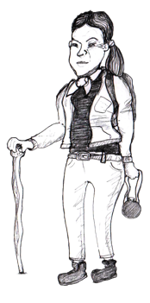
Carla Carlsbad
My Life as a Spelunker is not available in print.
Carla finds and reads her contract. She transferred all print, electronic, and digital rights to her publisher.
She has a reversion clause. It defines a work as “in print” if it is for sale in any format.
Carla checks online; finds it available as an e-book.
Is Carla eligible to exercise her reversion clause?
Notes:
Let’s examine another hypothetical.
Carla is the author of a memoir entitled My Life as a Spelunker. Disappointed that her memoir is not available in a printed format, Carla is considering trying to revert rights to once again make her memoir available in print. She begins by finding and reading her contract. She sees that she transferred the right to publish print editions of her memoir to her publisher, so she knows that she will need to revert rights or otherwise secure her publisher’s permission in order to make her book available for purchase in print.
Carla also sees that she has a reversion clause, and that it defines a work as “in print” if it is available for sale in any format. In order to determine whether this triggering condition has been met, Carla must investigate whether her memoir is available for purchase in any format. She checks online and finds that My Life as a Spelunker is available as an e-book.
Q: In light of all this information, is Carla eligible to exercise her reversion clause?
A: No, because her contract defines a work as “in print” if it is available for sale in any format and her book is available as an e-book. Carla will need to negotiate a reversion of rights, or another compromise with her publisher, if she is to make the book available in print.

Slide 27
Strategize: Build Your Case
Is your publisher no longer earning revenue on your work?
Is your publisher not utilizing all the rights you transferred to it?
Does your publisher have no plans to renew your work’s availability or sales?
BE REASONABLE
BE FLEXIBLE
BE CREATIVE
BE PERSISTENT
Notes:
Many authors are like Carla Carlsbad, because they are not eligible to exercise their reversion clauses, because they don’t have a reversion clause in their contracts at all, or maybe because they don’t have a copy of their contract and so they don’t even know if they have a reversion clause. If this describes your situation, don’t worry. You may still be able to achieve your goals for your book by opening a dialogue with your publisher about how you want to make your book available.
Like all authors, you should first consider what it is you want to do with your book. Then, consider strategies to bolster your bargaining position as you negotiate with your publisher. For example:
If your royalty statements demonstrate that your publisher is no longer earning revenue on your book, then it might make financial sense for the publisher to revert the rights to you. Doing so frees a publisher of the financial responsibility of keeping the book in stock, paying taxes on its inventory of the book, and producing annual accountings for your book. After all, it is inefficient for a publisher to track and send royalty statements to an author whose book has had no sales. This is a very compelling reason for publishers to revert rights to an author, and this is especially true if the author has already earned back the advance the publisher paid to him.
Another argument you can make is that your publisher is not actually using all the rights you transferred to it in your contract. If this is the case, present a reasonable argument for why you should be allowed to use those rights yourself. For example, if you transferred to your publisher the right to release translations of your work, but your publisher has yet to do so, then you can explain that you want to release a foreign language edition of your work in the hopes of reaching new markets. If your publisher is still not interested in doing so, you can use this as leverage in your effort to convince your publisher to either revert the necessary rights to you or otherwise grant you permission to release the translation yourself.
Likewise, if your publisher does not have any plans for a future marketing push or to make your book available via new technologies, explain that it is in the best interests of your book that it turns over those rights to you. If a book is languishing on a publisher’s backlist, and the publisher has no plans to try to reinvigorate sales, publishers may be willing to consider reversion.
Regardless of why you believe your publisher should revert rights to you, in the course of your conversations with your publisher, it is important to remain reasonable, flexible, creative, and persistent. Let’s explore these “golden rules” in more detail, to see how you can apply them to your own situation.

Slide 28
BE REASONABLE
Remain courteous and professional. Appeal to your publisher’s sense of reason.
Notes:
Be reasonable: Publishers view this as a conversation, and many want to do what’s best for their books and their authors. Recognize, though, that publishers may have reasonable justifications for hesitating to grant an author’s request—they are businesses, after all. Improve your chances by remaining courteous and professional, and using reasonable arguments.

Slide 29
BE REASONABLE
Katie Hafner
Presented reasonable arguments alongside evidence of reader preferences to convince publisher to publish paperback edition
Notes:
This is Katie Hafner, an author and journalist. Katie realized that her publisher had stopped printing her book A Romance on Three Legs, instead making it available only as an e-book. Her readers were constantly reaching out to her, requesting information on where they might purchase a physical copy of her book. Katie felt strongly that, in order to reach her target audience, her book had to be available for purchase in print. Katie was not eligible to revert rights under the terms of contract. Nonetheless, she explained to her publisher that her audience was more likely to purchase a traditional print copy than an e-book, and she actually sent a screenshot of her readers’ requests for print copies. Katie remained reasonable and courteous throughout her negotiations, and ultimately, she successfully persuaded her publisher to make her book available for purchase in print again.

Slide 30
BE FLEXIBLE
Be open to solutions other than the one you have in mind. Consider compromises.
Notes:
Be flexible and open to alternative solutions. Being flexible will increase your chances of coming to a mutually satisfactory agreement with your publisher.
For example, be open to allowing your publisher to renew marketing efforts on your book’s behalf before reverting rights, or to allowing your publisher to publish the e-book version of your book themselves, rather than revert the digital and electronic rights to you so that you can do so.
Another way to be flexible is to consider reverting only the rights you need to accomplish the goals you have, instead of insisting on reverting all the rights in your book. For example, if you want to publish an audio edition of your book but your publisher doesn’t want to, you only need to revert the audio rights. Your publisher can keep the other rights in the book.
Another example of being flexible is considering the possibility of allowing your publisher to keep the rights, but to grant you permission to do what you want with your book. For example, if you want to make your book available in your university’s online open access repository, consider just getting permission from your publisher to do so rather than insisting on reverting the rights in the book.

Slide 31
BE FLEXIBLE
Barbara Waxer
Publisher waived non-compete clause and allowed her to use content in future works
Notes:
An author whose story exemplifies the principle of flexibility is Barbara Waxer. She is a college instructor and the author of several textbooks. Barbara arrived at a successful compromise with her publisher to release a revised version of one of her books for use in college courses, which was her goal. There is a bit of a twist here, because her publishing agreement included a non-compete clause that prevented her from releasing other books that might compete with the publisher’s version. Her publisher also refused to revert the rights to her because the book was still technically in print, even though it was barely selling any copies. After much back-and-forth, Barbara was able to convince her publisher to waive the non-compete clause and grant her permission to use her content in future works, so long as she credited the publisher. Barbara is happy with this arrangement because, even though it is not a rights reversion, she can still take advantage of new market opportunities and create a revised version of her book.

Slide 32
BE CREATIVE
Each author, book, and contract is different. Think broadly about how to increase availability.
Notes:
Be creative: Each situation is unique, and might have a unique solution—think outside the box.
For example, are you tech savvy enough to produce a digital file of your book? If so, your publisher might be more willing to publish an e-book version of your book, since they won’t have to incur the expense of producing the file themselves. In a similar vein, has your book already been scanned as part of HathiTrust’s efforts but is nonetheless sitting in the dark because your publisher still holds the rights? Consider working with your publisher to give permission to HathiTrust to display the full text online.

Slide 33
BE CREATIVE
Jessamyn West
Used crowdfunding to raise funds to pay her publisher to regain rights so she could release her book on open terms
Notes:
Jessamyn West is a librarian and author of the book Without A Net. She wanted to make her book more widely available and decided to pursue a rights reversion in order to make it freely available online under a Creative Commons license. Her publisher agreed to revert rights to the book, but requested a fee of $2,000 to release the rights. Not one to be easily discouraged, Jessamyn partnered with Unglue.it, a nonprofit site that hosts fundraising campaigns to support books being made available under Creative Commons licenses. Through her willingness to be creative and think outside the box, Jessamyn successfully used crowdfunding to raise the funds she needed to buy back the rights to her book and make it openly available online.

Slide 34
BE PERSISTENT
This process can take time. Be your own best advocate by being patient and persistent.
Notes:
Be persistent: Even when you have a straightforward contractual right of reversion, this process can take time. You might have to contact your publisher several times over several months before your request is granted. All authors benefit from persistence—whether it means circling back to publishers to remind them about your reversion request, continuing to politely pursue mutually satisfactory agreements, or continuing to find ways to make your books available yourself. Be your own best advocate by being patient and persistent! That said, be sure to follow-up with your publisher within reason… you don’t want to bombard them.

Slide 35
BE PERSISTENT
Jeff Hecht
Reverted rights to future editions and convinced publisher to allow him to sell low-cost PDF and print-on-demand versions of current edition
Notes:
This is Jeff Hecht. Jeff writes books about lasers, fiber optics, dinosaurs, and other fun science topics. The fifth edition of Jeff’s book Understanding Fiber Optics was published in 2005, but sales petered out over time. Someone approached Jeff about writing an updated sixth edition, but his publisher didn’t think it could effectively market a new edition. Rather than give up on updating his work, Jeff persisted and convinced his publisher to revert the rights to all future editions of the work. He is now working on the sixth edition.
In the meantime, his publisher also stopped selling full copies of Jeff’s book, instead just printing single chapters in course packets. Jeff really wanted his full book to be available and accessible to readers, so he persisted and convinced the publisher to allow him to sell full copies of the book so long as he makes clear that they published the original edition. He has now made the book available at a significantly lower price as a PDF file and as a print-on-demand edition. The first student to purchase the cheaper PDF file was a student in Botswana searching for an affordable introduction to fiber optics. Jeff says that he cannot think of a better symbol of his goal of making his book more broadly accessible.

Slide 36
Do you need to revert rights to do what you want?
NO
Proceeding without a right of reversion
NO
YES
NO
BE READ!
YES
YES
Does your contract include a reversion clause?
Are you eligible to exercise your reversion clause?
Notes:
To recap: even if you don’t have a reversion clause or you are not eligible to exercise your reversion clause, you can still get your rights back or otherwise make your book available in the ways you want. By following these “golden rules” of being reasonable, flexible, creative, and persistent, the authors I’ve featured today have been able to give their books new life.

Slide 37
What Are You Waiting For?
It is Just a Conversation
It is Worth the Time
There’s a Solution for Everyone
You Can Do It on Your Own
Notes:
In addition to the success stories I just shared, many other authors have achieved their goals for their books as well, whether by reverting rights or negotiating a different compromise with their publishers.
Some authors don’t even consider reverting rights, or entering into negotiations with their publishers to increase their book’s availability, out of a misplaced fear that the process will involve too much conflict, take too much time, or that their book is just not a good candidate for reversion. These concerns should not keep your book in the dark.
Increasing your book’s availability is worth the time. Think about how much time you invested into researching, writing, and editing your book. Isn’t it worth it to invest a few more hours in your book by negotiating with your publisher, so that you can keep your work accessible to the audience for whom you wrote it?
It’s just a conversation. Author negotiations with publishers—whether they are for reversion or some other compromise—are civil affairs. There is no need for conflict, especially if you follow the tools and strategies outlined today.
This is something you can do on your own. As many of the success stories I’ve just shared demonstrate, authors generally don’t need to hire expensive lawyers or engage a literary agent to revert rights to their books.
There is a solution for everyone. Some authors are hesitant to try to revert, or negotiate a compromise with their publishers, because they feel that their book is not a good candidate and that their publisher will refuse them. But you never know what kind of compromise your publisher might be willing to reach with you.

Slide 38
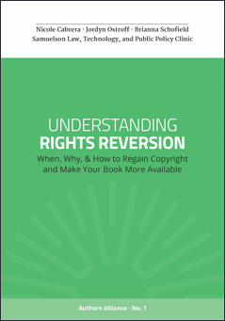
Further Resources: Authors Alliance
authorsalliance.org/resources
Guide to Understanding Rights Reversion
Templates for writing rights reversion letters
...and more
authorsalliance.org/join
Notes:
I hope today’s presentation prompts you to consider whether reversion is right for you. If it has sparked your interest in getting your rights back, I encourage you to check out additional resources created by Authors Alliance, a nonprofit organization that helps authors understand and manage their rights. The Authors Alliance guide to rights reversion is freely available online, and will give you additional information, tips, and strategies on how to make your books available in the ways you want. The Authors Alliance website also has templates for writing rights reversion letters and inspirational success stories from authors who have successfully reverted rights.
Authors Alliance membership is free; consider joining as an individual member to receive updates about their new resources and to learn more about leveraging your rights as an author.

Slide 39
Credits
Authors Alliance is grateful to Arcadia – a charitable fund of Lisbet Rausing and Peter Baldwin - for a grant that supported the creation of these slides.
Thanks to the creators who made and released these resources for free:
Graphics (slides 4, 9, 12) and icons by SlidesCarnival, CC-BY 4.0
Welcome sign (slide 2) by Belinda Fewings on Unsplash
Signpost (slide 3) by Deanna Ritchie on Unsplash
Books (slide 5) by Jason Leung on Unsplash
Chess pieces (slide 26) by Nietjuh on Pixabay
Party balloons (slide 36) by Lidya Nada on Unsplash

