Slide 1
FOLLOW THE MONEY
Advances
Royalties
Accounting
Notes:
In this section of the presentation, we’ll cover the basics of how you might be compensated for your work, including through advances and royalties. We’ll also address how your publisher will account for and share information about the sales of your work.

Slide 2
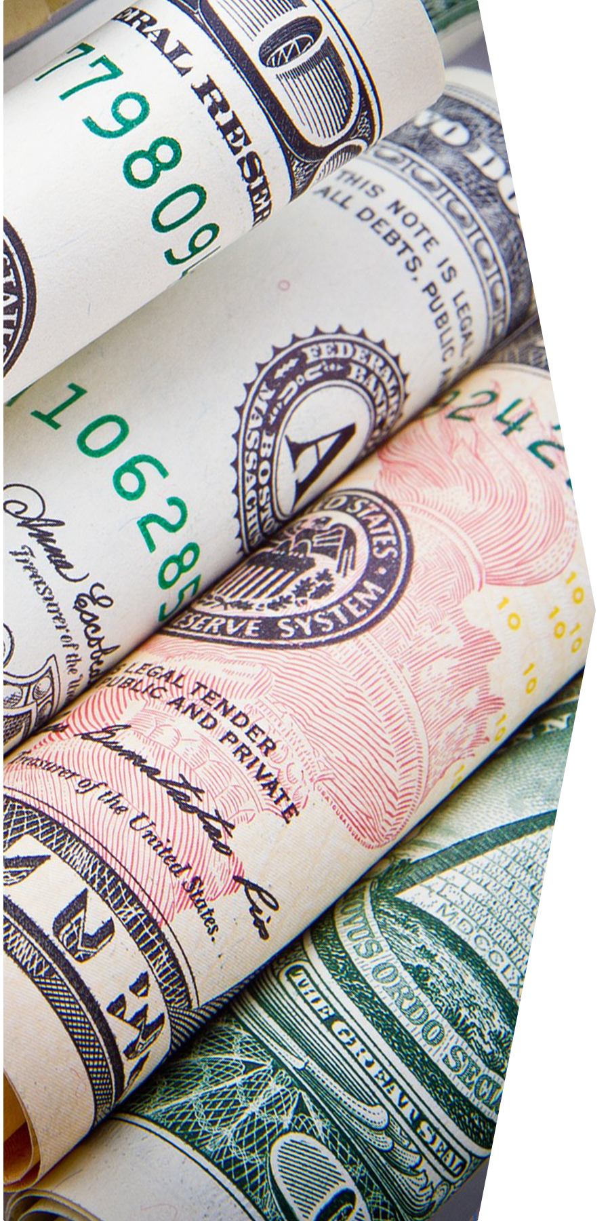
Advances
Upfront payment received for book (often credited against all or part of your future earnings).
Author-Friendly Options
Advances are sometimes broken into two or more payments. Consider milestones for payment carefully.
Some authors want a large advance to incentivize publisher to market book aggressively, others accept low or no advance in exchange for higher royalties (or better terms in another part of the contract).
Pay attention to how your advance will be recouped.
Notes:
Often, the first payment you’ll receive from your publisher will be an advance, which is a payment credited against all or some part of your future earnings. Note that while advances are typical in trade publishing, they are uncommon for scholarly works published by university presses. If you receive an advance, your book must first earn back this amount before you’ll receive any additional royalty payments (and possibly other payments). This is often called earning out or recouping your advance. An author’s advance is influenced by many factors, including the potential market size for the book, whether the author is a new or established writer with an existing audience, the book’s timeliness and competition, and a publisher’s calculation of risk and reward.
Advances are sometimes broken into two payments: half when the book contract is signed and the other half when the final manuscript is delivered to the publisher. However, some publishers follow a different payment schedule, and a recent trend is to break the advance into three, four, or even five payments. You may want to think about what payment milestones make sense for your project. For example, some common milestones are the signing of the contract, delivery of the manuscript, acceptance of the manuscript, or publication. Be sure you understand the amounts that will be paid and what’s required for each milestone, and make sure this works with your needs.
Regarding the size of an advance, unfortunately there aren’t any hard-and-fast rules about the size of an advance. Some authors want a large advance to incentivize publisher to market book aggressively, others accept low or no advance in exchange for higher royalties (or better terms in another part of the contract).
Whatever the size of the advance you settle on, it’s important that you pay attention to how your advance will be recouped. Commonly, an advance is credited against “all earnings” under the contract with the publisher, meaning both royalties and money earned from subsidiary rights that are licensed to third parties, such as translation rights or movie rights. Sometimes, an advance is credited only against royalties. You may want to try to limit recoupment of your advance to royalties rather than “all earnings” because this means you could see some additional money sooner.

Slide 3
Repaying Advances
Understand what happens if you don’t earn out the advance.
Understand whether your contract has a cross-collateralization clause.
Understand other situations in which you may have to repay advance and where repayment comes from.
Notes:
Another thing to pay attention to is what happens if your book doesn’t earn out its advance. In some rare cases, your contract may specify that you have to repay the part of your advance that doesn’t earn out. This shifts a lot of financial risk to you, so if your contract includes such terms, you may want to negotiate them out. But in most cases, you just won’t receive any royalty payments until the advance is fully recouped.
It is also important to understand whether your contract includes a cross-collateralization clause. These clauses allow the publisher to recover any unearned advances from one book against money coming from another book by the same author.
Finally, it is important to understand other situations in which you might have to repay your advance. Your contract may include language requiring you to return the advance if the manuscript is unsatisfactory or if you fail to deliver the manuscript to the publisher on time (or at all). If your contract requires repayment of your advance under these circumstances, then pay close attention to where the repayment funds will come from. Sometimes, the advance must be repaid immediately upon termination of the book contract, which likely means you’ll have to pay out of pocket. A better option is to include a first proceeds clause. This type of clause specifies that any money you receive from a future publication contract for the same work must be used to repay your publisher. In other words, you get to delay paying back your advance to your first publisher until you’ve struck a deal with another publisher.

Slide 4
Royalties
The amount of money that authors get from the sales of their books, usually expressed as a percentage.
Published Price Royalties
Net Income Royalties
Net Profit
Royalties
Royalties are based on the amount the publisher receives from retailers/ distributors.
Royalties are based on the retail price.
Royalties are based on the amount of profit that is left after publisher deducts costs.
Notes:
Royalties are the amount of money that authors get from the sales of their books, usually expressed as a percentage. You need to pay attention to how exactly your royalties are defined and calculated. Suppose that your contract specifies that you’ll receive “10% of retail book sales.” Great, you might say, but what does “retail book sales” mean, and how is it calculated? These are the key questions to ask as you’re negotiating your royalty terms as there are a few different ways to define and calculate sales for royalty purposes.
First is royalties based on the book’s published price (also called the “list price,” the “cover price,” or the “manufacturer’s suggested retail price”). Second is royalties based on the publisher’s net income from sales of the book (also called “price received” or “sales proceeds”). And third is royalties based on the publisher’s net profit.

Slide 5
Royalty Models Matter
The royalty basis can affect an author’s bottom line.
Published Price Royalties
Net Income Royalties
Net Profit Royalties
Alfredo Author’s book sells for $20 list price at bookstores. His contract specifies a 12% published price royalty, meaning he will earn $2.40 per book sold.
Bookstores buy Alfredo Author’s book wholesale for $16 each. His contract specifies a 12% net income royalty. Therefore, he earns $1.92 for every book the stores buy.
Alfredo Author’s book sells for $20, but his publisher incurs $15.20 in costs, netting $4.80 per book. His contract specifies a 12% net profits royalty rate. He earns $0.58 for each book sold.
Notes:
To calculate your royalties under any of these systems, you’ll need to know both the percentage you will be receiving and the price from which that percentage is taken. While this may seem overly technical, it can make a huge difference in your future bank statements. To illustrate, let’s look at how the royalty basis can affect an author’s bottom line.
Let’s start with published price royalties. If Alfredo Author’s book sells for $20 at bookstores and his contract specifies 12% royalties on the published price, Alfredo will earn $2.40 for each book sold. However, if Alfredo’s royalties are based on net income, we instead need to look at the wholesale price of the book, which we’ll say is $16 for this example. If his royalty rate is 12% of net income, Alfredo will earn $1.92 for every book sold. And under the net profit model, if Alfredo’s publisher nets $4.80 for each book after costs are deducted and his contract specifies a 12% net profits royalty rate, he will only earn 58 cents for each book sold.

Slide 6
Royalty Models Matter
It is possible to earn the same amount per book under each accounting method.
Published Price Royalties
Net Income Royalties
Net Profit Royalties
Alfredo Author’s book sells for $20 list price at bookstores. His contract specifies a 12% published price royalty, meaning he will earn $2.40 per book sold.
Bookstores buy Alfredo Author’s book wholesale for $16 each. His contract specifies a 15% net income royalty. Therefore, he earns $2.40 for every book the stores buy.
Alfredo Author’s book sells for $20, but his publisher incurs $15.20 in costs, netting $4.80 per book. His contract specifies a 50% net profits royalty rate. He earns $2.40 for each book sold.
Notes:
On the flip side, it’s possible to earn the same amount per book under each accounting method, even if the percentage rates are wildly different. Let’s look at some examples to see how this plays out.
If Alfredo Author’s book sells for $20 at bookstores and his contract specifies 12% royalties on the published price, Alfredo will earn $2.40 for each book sold. However, if Alfredo’s royalties are based on net income, and his book wholesales for $16, if Alfredo earns a 15% net income royalty his earnings will still be $2.40 per book. And under the net profit model, if Alfredo’s publisher nets $4.80 for each book after costs are deducted and his contract specifies a 50% net profits royalty rate, he will still earn $2.40 for each book sold.
To summarize, it is important to not only understand the royalty rate you are being offered, but to understand how that interacts with what you are being offered a percentage of, whether that is list price, net income, or net profits.

Slide 7
Royalties
Other factors can influence your royalties, including:
Escalations: specify an increased royalty rate as more copies are sold.
Small reprintings: reduce royalties when a small reprinting is made (often <1000 copies).
Deep discounts: reduce royalty rates for heavily discounted sales.
Reserves on returns: allow a publisher to withhold a portion of author’s royalties against returns of unsold books.
Notes:
Royalties can also be influence by a number of other factors. For example, some contracts include escalation clauses that specify that the royalty rate will increase when more copies of a book are sold. On the flip side, some contracts specify that royalties will be reduced for small re-printings (typically under 1000 copies) and when your books are included in heavily discounted sales, often called deep discounts.
Your royalties will also be affected statement-to-statement by reserves that the publisher withholds against returns of your books by bookstores.

Slide 8
Accounting
Control how publisher tracks and shares info about financials related to publishing and licensing your work.
Author-Friendly Options
Require that the publisher provide regular accounting statements, and specify what info statements will include.
Specify when and how your royalties get paid and what recourse you have if payments are not timely made.
Understand how licensing income is paid (consider a pass-through clause).
Provide for the right to audit the publisher, specifying documents to be made available and allow a reasonable “look back” period.
Notes:
Publication contracts typically require publishers to provide regular accounting statements. These documents list all revenues from sales of your work, in all formats, during a set period. Semi-annual or annual statements are the norm, though some publishers will issue more frequent statements.
Even if your book is not a big money maker, it is a good idea to specify in the contract that you will receive detailed accounting statements at regular intervals. Beware of provisions that provide an accounting statement only when the sum owed is greater than a certain amount, such as $50. If sales remain low for a long time, authors will often stop receiving regular statements, which makes it difficult to keep track of how many books have ultimately been sold. Even if your book isn’t selling well, information about the number of books sold, revenue, and the like is important to know, especially if you try to exercise the rights reversion clause in your agreement (we’ll talk about these clauses in the next section of the presentation).
Your contract should also specify when your royalties get paid, how they get paid, and how you can remind the publisher to make the payment. If your contract doesn’t include this, you may want to add some clarifying language. You may want to consider how any licensing income (the money made from licensing your work for use by third parties) is paid, as opposed to royalty income. If you expect to receive significant income from licensing, you might want to try to add a pass-through clause (also called a flow-through clause) to the payment section of your contract. This provision obliges your publisher to “pass through” income made from licensing on a regular basis (often monthly), rather than waiting to include it in an annual or semi-annual accounting of royalties.
Your contract should also give you the right to double-check that your publisher has correctly tallied up the sales of your book and is paying you the proper amount—that is, the right to audit your publisher. The audit clause specifies exactly how you can request, and conduct, an audit. Without this clause, publishers are not contractually required to comply with an audit request or to provide access to records.

Slide 9
Credits
Authors Alliance is grateful to Arcadia – a charitable fund of Lisbet Rausing and Peter Baldwin – for a grant that supported the creation of these slides.
Thanks to the creators who made and released these resources for free:
Graphics (slides 1, 3, 5, 6) by SlidesCarnival, CC-BY 4.0
Dollars by Nikolay Frolochkin on Pixabay
Piggy bank by Fabian Blank on Unsplash
Sale sign by Claudio Schwarz Purzlbaum on Unsplash
Abacus by Crissy Jarvis on Unsplash

