Slide 1
Fair Use for Nonfiction Authors
Test Your Understanding

Slide 2
Test Your Understanding
Bernard Biographer theorizes that Francie Francophile’s two years in Paris had a profound influence on her song writing. Bernard wants to use excerpts of Francie’s diary and lyrics from her songs in his biography, The Sway of the Seine, to document the connection between Francie’s Parisian adventures and the themes in her discography.
Could this use be fair?
Notes:
Q: Bernard Biographer theorizes that Francie Francophile’s two years in Paris had a profound influence on her songwriting. Bernard wants to use excerpts of Francie’s diary and lyrics from her songs in his biography, The Sway of the Seine, to document the connection between Francie’s Parisian adventures and the themes in her discography.
Could this use be fair?
A: Since Bernard wants to use the copyrighted material from Francie’s diary and songs to lend credibility to his theory, his use is fair-use eligible under the principle #2. However, if he wants to stay comfortably within the bounds of fair use, Bernard will need to review the limitations to this principle. Bernard will find that the limitations suggest that he should limit the length of excerpts from Francie’s diary and lyrics from her songs to an amount that will allow his reader to assess the validity of his theory about her time in Paris and her songwriting, but no more. What amount is “reasonable” depends on the context. For example, at some point in his book Bernard may need to copy several entries from Francie’s diary to lend credence to his theory, but at another point, a choice quote or two may be sufficient. Likewise, in some cases Bernard may need to use several verses from Francie’s songs to support his point, while in other cases a line or two will suffice. Moreover, Bernard should avoid including passages from Francie’s diary or lyrics from her songs that are entertaining but unrelated to the points he is making in his biography. Finally, Bernard should credit the material to Francie in a reasonable manner.

Slide 3
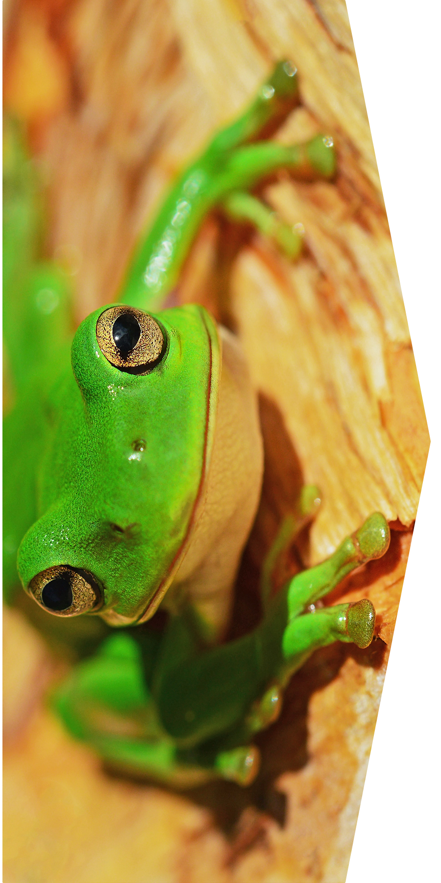
Test Your Understanding
Amy Amphibian wants to create a database of scientific articles and use data mining technology to evaluate how frequently a particular species of frog is used for scientific research and testing.
Could this use be fair?
Notes:
Q. Amy Amphibian wants to create a database of scientific articles and use data mining technology to evaluate how frequently a particular species of frog is used for scientific research and testing.
Could this use be fair?
A: Because Amy wants to create a digital database of copyrighted material for non-consumptive analysis across the collection or articles for scholarly purposes, her use is fair-use eligible under principle #3. However, Amy will need to review the limitations to this principle to ensure that her use stays within the bounds of fair use. Amy will find that the limitations suggest that she should not use the copyrighted material in other ways (for example, to provide digital access to the entire text of the articles), unless she has an independent justification for doing so (such as a license from the rights holder). Amy should also review the terms of use governing her access to the articles to see whether she is bound by any contractual limitations on use.

Slide 4
Test Your Understanding
Art historian Martha Marx wants to include reproductions of Freddy Fresco’s paintings in her book Class, Clout, and Color, which analyzes how class and power struggles are reflected in the artist’s work.
Could this use be fair?
Notes:
Q: Art historian Martha Marx wants to include reproductions of Freddy Fresco’s paintings in her book Class, Clout, and Color, which analyzes how class and power struggles are reflected in the artist’s work.
Could this use be fair?
A: Since Martha Marx is specifically discussing Freddy Fresco’s paintings, her use is fair-use eligible under principle #1. However, Martha will need to review the limitations to this principle to ensure that her use does not exceed the limits of fair use. When reviewing the limitations, Martha Marx will find that she should only use as much of Freddy’s paintings as reasonably appropriate to enable her reader to understand her analysis of how class and power struggles are represented in Freddy’s works. What amount is “reasonable” depends on context. In some situations, Martha may only need to use a thumbnail or section of one of Freddy’s paintings to communicate her point. In other cases, she may need to reproduce an entire painting in detail for her point to be clear. Further, Martha should make it clear in the text of her book why each work has been reproduced. Finally, she should credit the paintings to Freddy Fresco in a reasonable manner.

Slide 5
Credits
Authors Alliance is grateful to Arcadia – a charitable fund of Lisbet Rausing and Peter Baldwin – for a grant that supported the creation of these slides.
Thanks to the creators who made and released these resources for free:
Icons slide 1 by SlidesCarnival, CC-BY 4.0
Paint by Denise Johnson on Unsplash
Frog by David Clode on Unsplash
Eiffel Tower by Chris Karidis on Unsplash

